Slide 1
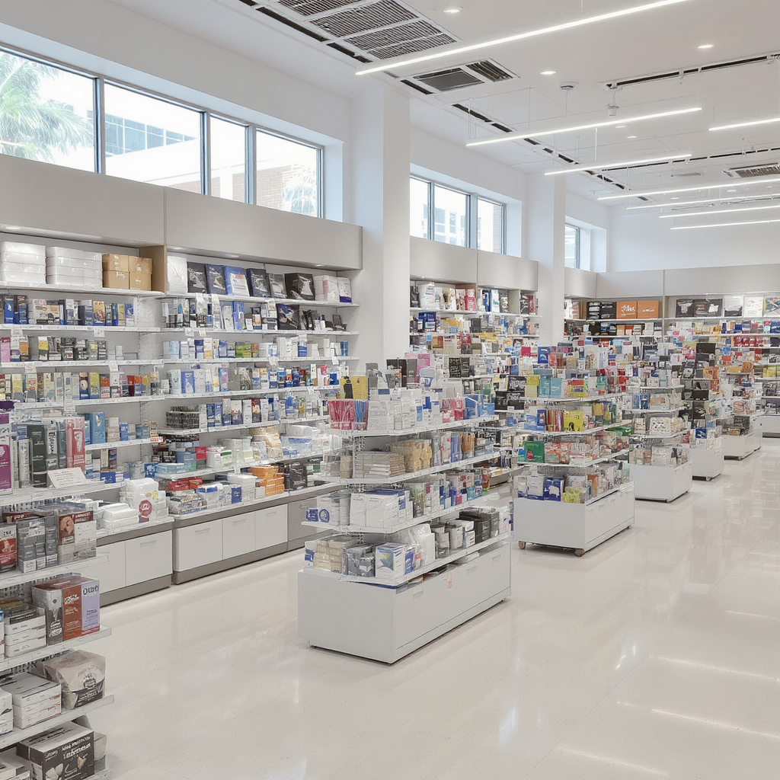
Foot Traffic and Dwell Time Trends at Office Supply Stores During the Remote Work Shift
Management of Organizational Data Group Project
Group 7

Slide 2

Weekly Visits of Office Supply Brand
Staples, clear volume leader, more resilient pre-shock, but just as exposed during the drop

Slide 3
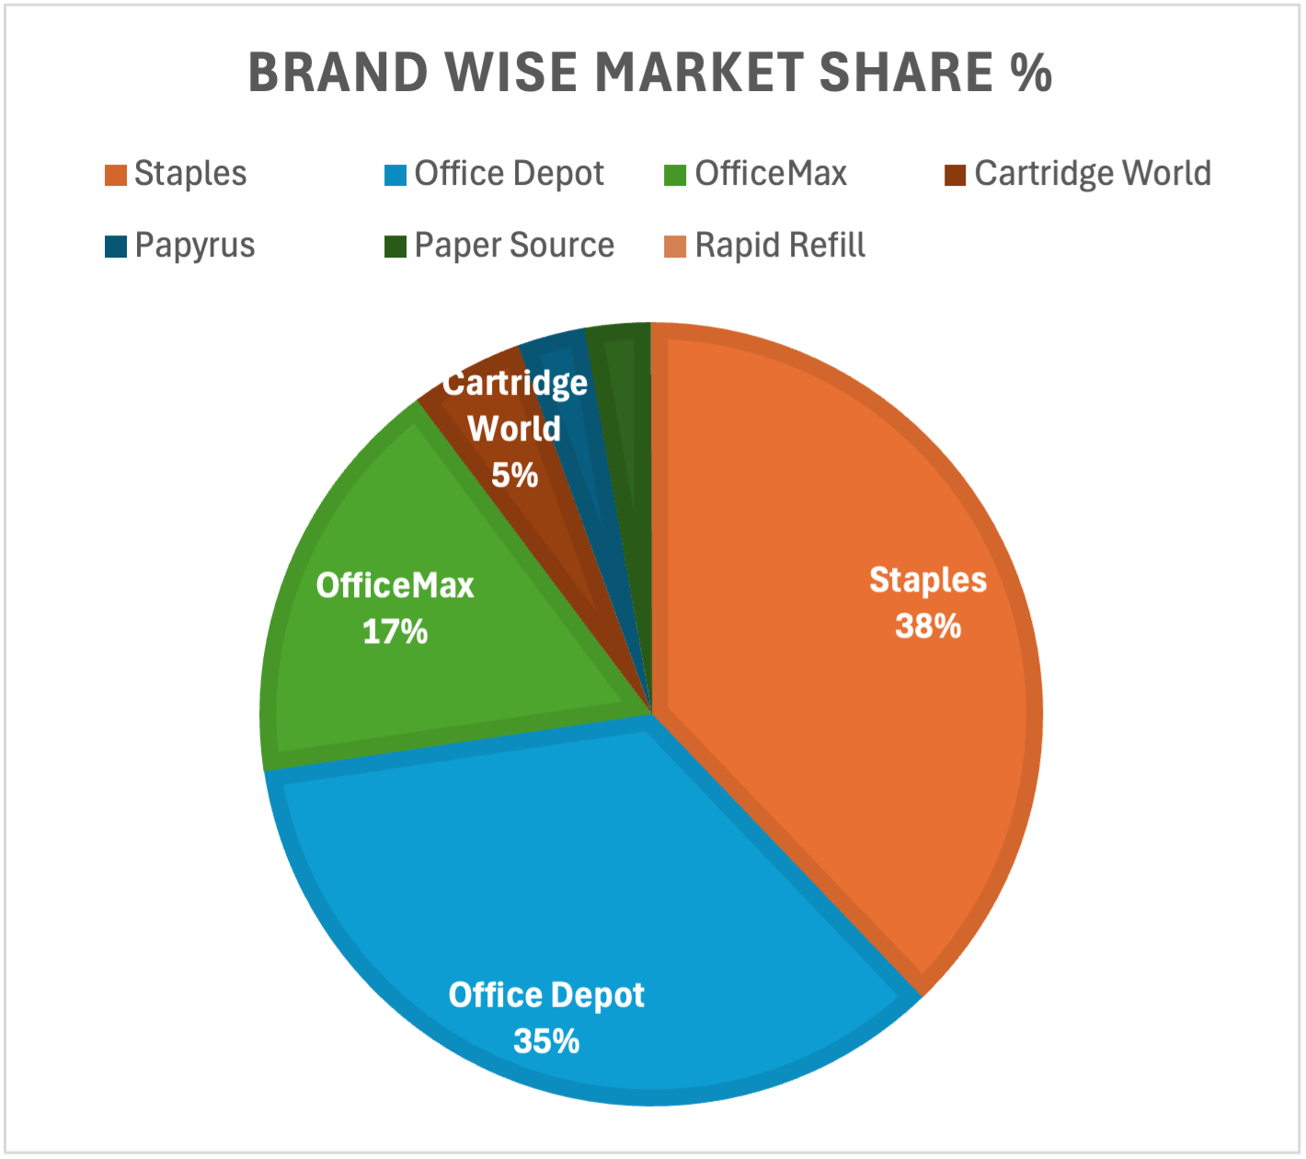

Market Share Landscape of Office Supply Brands
Staples captures the largest market share at 38%; Office Depot holds a 35% share
The market is highly consolidated, dominated by two key players – Staples and Office Depot
Niche and experiential brands can sustain only through differentiation, personalization, or e-commerce expansion.

Slide 4
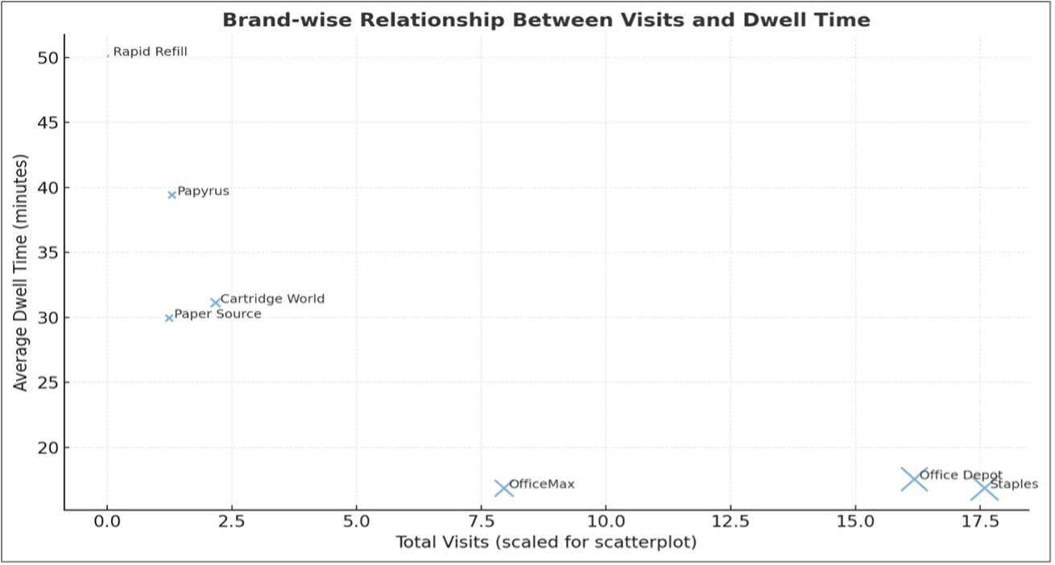
Brand wise Relationship Between Visits and Dwell Time
Staples and Office Depot attract the most visits but have short dwell times, reflecting quick, mission-driven purchases.
Despite high foot traffic, staples show shorter dwell times (~20 mins)
Rapid Refill stands out with the highest dwell time (~50 min), showing strong engagement within a narrow customer base

Slide 5
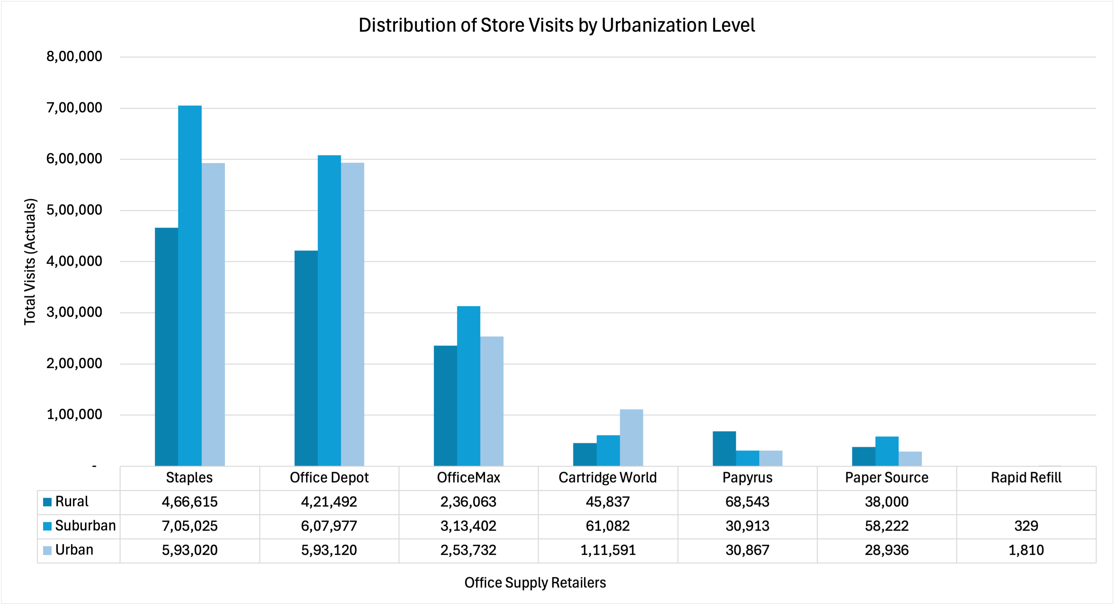
Measuring Urban vs. Rural Footprints of Office Supply Brands
Suburban visits dominate across all major brands; Urban areas trail slightly; Rural areas show steady but smaller visit counts
Staples (705K), Office Depot (608K), and OfficeMax (313K) all record the highest visits from suburban areas.
Urban areas trail slightly, despite higher population density, suggesting that suburban consumers were more actively purchasing home-office essentials when remote work began.
Rural areas show steady but smaller visit counts, reflecting fewer store locations and smaller populations.

Slide 6
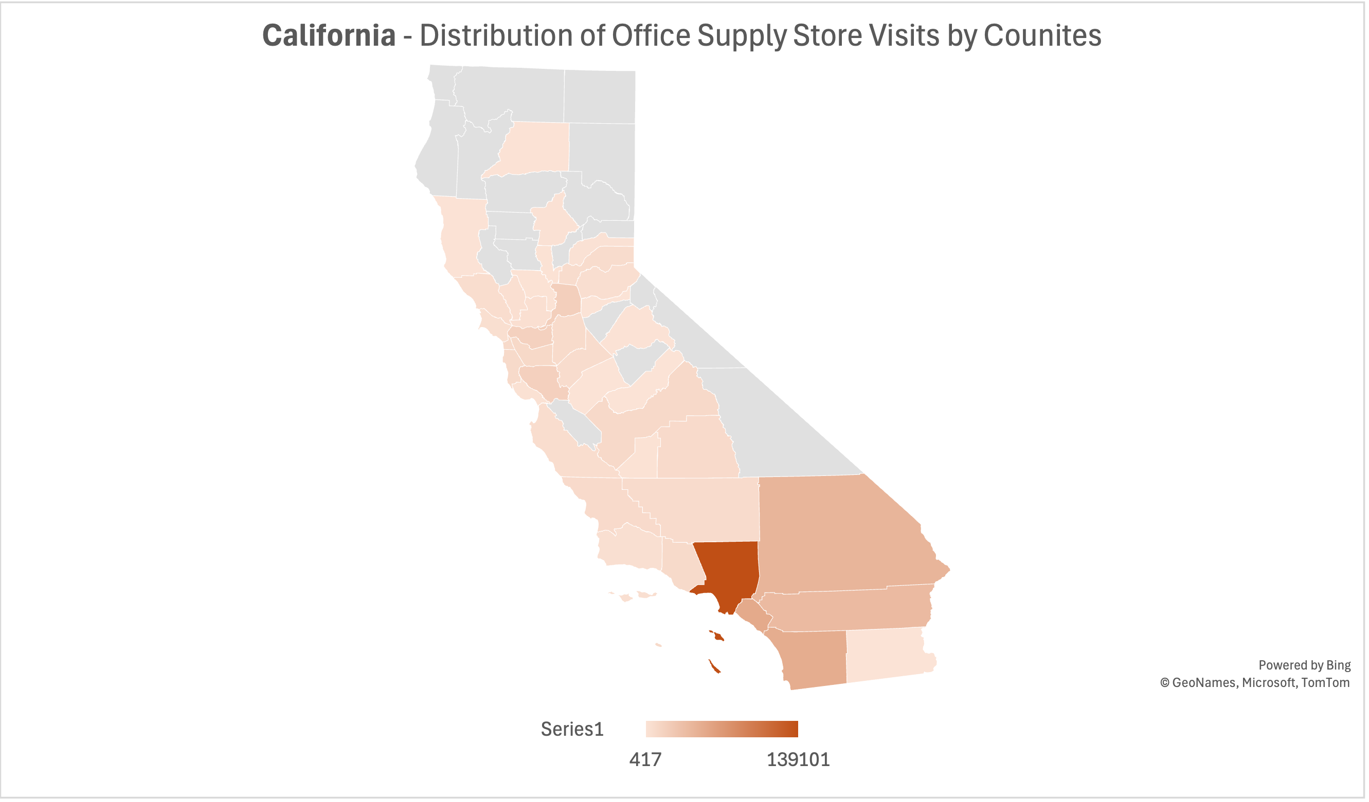
Distribution of Office Supply Store Foot Traffic Across California Counties
Southern California dominates office supply store visits, with Los Angeles County emerging as the primary hotspot (over 130K+ visits)
Urban centers along the coastal corridor (Los Angeles → San Diego → Bay Area) exhibit significantly higher retail engagement, suggesting strong dependence on in-person office purchases.
Neighboring counties like Orange, San Bernardino, and Riverside also show elevated activity — reflecting dense urban populations and commercial hubs.
Northern and Central California counties (e.g., Modoc, Sierra, and Lassen) show minimal visits, consistent with rural and low-density retail presence.

Slide 7
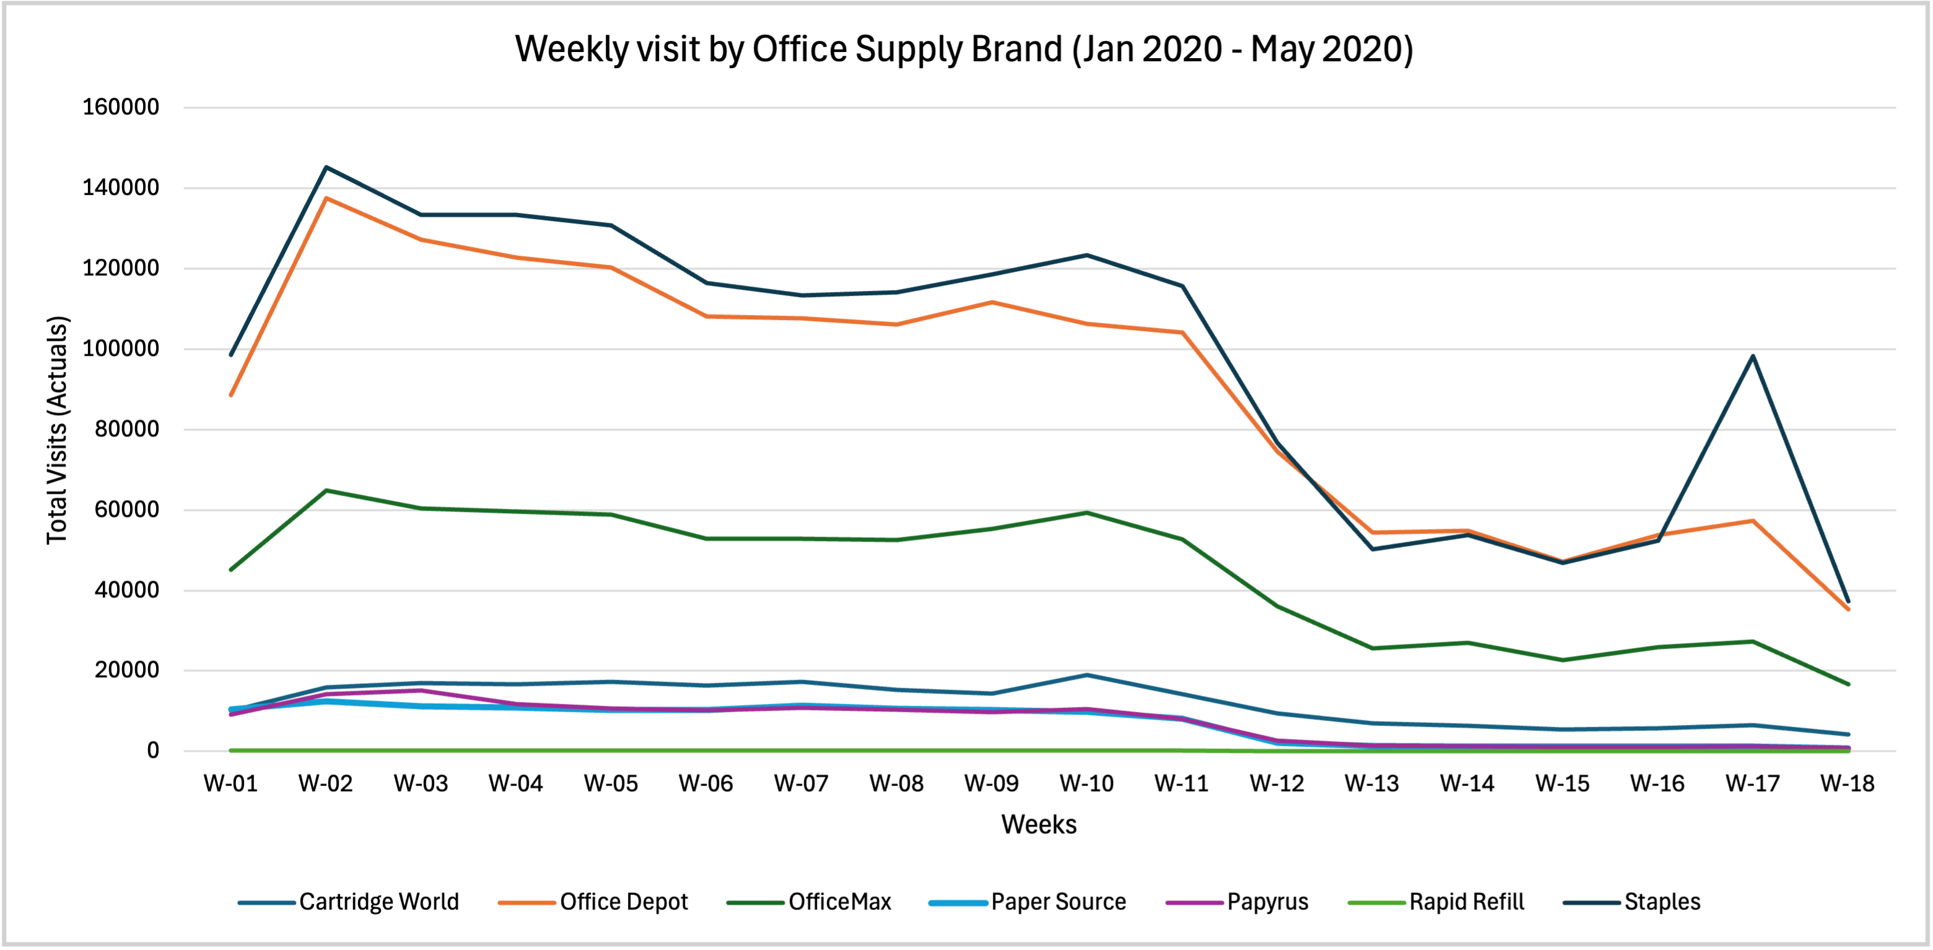
Brand Recovery Patterns: Early-2020 Stabilization in Office Supply Store Visits
Staples and Office Depot stabilized fastest, with WK 17 rebound suggesting quicker adaptation

Slide 8
Brand Recovery and Stabilization Trends: Jan–May 2020
Staples and Office Depot show early stabilization around Weeks 16–17, with visits rebounding by ~20–25%.
Brand | Stabilization Week | Recovery Pattern | Key Interpretation
Staples | WK 16–17 | Rapid rebound after steep mid-March dip | Strong brand loyalty and essential status drove early recovery; demand tied to home-office setup.
Office Depot | WK 17–18 | Gradual recovery and steady visits | Maintained consistent customer base; reflects reliability and convenience as essential retailer.
OfficeMax | WK 18 | Slower, moderate rebound | Some brand overlap with Office Depot may have diluted traffic; secondary player in essential category.
Cartridge World | WK 17 | Partial stabilization | Specialized product line led to moderate rebound; supported by printer and cartridge needs for remote work.
Paper Source | No clear stabilization | Visits remained low through April | Non-essential, creative products saw sustained decline; recovery delayed by reduced in-store browsing.
Papyrus | No clear stabilization | Continued decline post-March | Discretionary gifting and stationery purchases collapsed; slow adaptation to online demand.
Rapid Refill | Minimal activity | Stable at very low volume | Niche audience with deep but narrow engagement; limited market reach and low recovery potential.

Slide 9
Thank You

